Slide 1


Fraud, Bribery and Corruption Awareness
Artificial Intelligence in Recruitment Fraud
Presented by Colin Edwards - Local Counter Fraud Specialist

Slide 2


What is Artificial Intelligence (AI)?

Slide 3
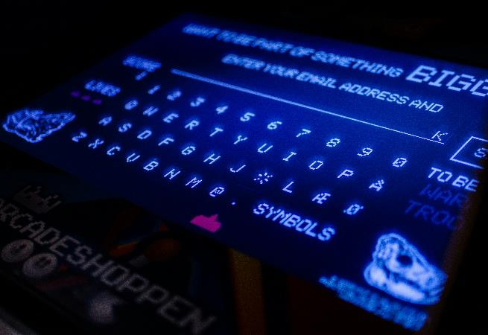

What is Artificial Intelligence (AI)?
AI is the science of making machines that can think like humans.
AI can do things that are considered "smart" such as reasoning, making decisions or solving problems.
AI is technology that can process large amounts of data in ways that humans cannot.
AI is to be able to do things such as recognise patterns, make decisions, and judge like humans.

Slide 4


Should we be worried and how good is AI?

Slide 5

Deep Fake Video
February 2024 – a company fell victim to a sophisticated scam that targeted its financial department. The attackers, used convincing AI-enabled deepfake technology to impersonate the company’s CFO.
From the deep fake video, fraudulent instructions were given to employees to transfer $25m to an offshore account.
Perpetrators used AI to create a deepfake video of the CFO, imitating voice and facial expressions to perfection.
The level of detail meant that employees did not spot the deception, even as the video instructed them to make an urgent and confidential money transfer.
The scam took advantage on the trust and authority associated with the CFO, exploiting the human tendency to comply with instructions from senior personnel.
The targeted company suffered a significant financial loss, and its reputation was damaged.

Slide 6

Recruitment Fraud and AI

Slide 7

How Does Morgan Freeman and CFO Deep Fake Videos Relate to AI in Recruitment Fraud?
Firstly, we need to understand what recruitment fraud is and acknowledge there is a fraud risk in respect of substantive employers and temporary workers.
Examples include……….
Applicant deliberately provides false information (e.g., false qualifications).
Applicant omits to provide information (e.g., criminal conviction).
Applicant embellishes information (e.g., work history responsibilities and/or experience).
Applicant colludes with others (e.g., to submit false references or with an agency regarding right to work).
Applicant knows that their actions would affect their offer or continued employment (failure to disclose changes).
False identity or imposters.

Slide 8


AI in Application Forms and CVs
Is this any different to a candidate seeking help from a family member, colleague or friend to complete the application?
AI-generated job applications can:
Be populated through AI autofill tools.
Be generic and impersonal and not truly reflect the candidate’ personality.
Fail to use the candidate's language or highlight any language incompetencies.
Fail to accurately reflect an applicant's knowledge, skills, and experiences.
Generate false or misleading information.
Embellish the facts.

Slide 9


AI in Interviews
Online Interviews becoming more common place?
Is the candidate required to make a verbal declaration around support and use of AI in the interview?
Do we have assurance that the person we are interviewing is the candidate?
Do we see them again following a job offer?
Is the candidate’s camera on?
Does the candidate have a second device/screen (can you see their hands)?
Is the person engaged or distracted (e.g., typing on a device)?
Does the candidate mute and pause before answering a question?
Is the candidate wearing an earpiece/listening device?
Is there someone else in the room (using AI)?
We may not be interviewing Morgan Freeman just yet, but AI technology is progressing fast!

Slide 10

Potential red flags
Stilted, impersonal language (robotic sounding or plain).
Inconsistency in the language, writing style or tone of voice throughout application.
The over-use of semi colons.
Overly long or complex sentences that have a range of unusual vocabulary, patterns or phrases.
Far reaching or unexplained gaps in employment.
Content similar to or mirrors other applications (bulk applications).
Incomplete answers on applications.
No trace of previous employers with an e-footprint.
Non-business emails used for references.
Alternative managers/colleagues given as referees.
No matching Identity documents / pictures.
………….. If it doesn’t feel right, then make enquiries and gain assurance!

Slide 11

Mitigate the Risk

Slide 12

NHS Employers ‘Pre-employment checks’ Standards
Requirement under the NHS Standard Contract (General Condition 5.11).
Includes agency or other external third-party providers.
Organisations must assure themselves that the agency carries out pre-employment checks in compliance with NHS Employment Check Standards.
Keep true to the Standards
Identity checks
Criminal record checks
Work health assessments standard
Professional registration and qualification checks
Right to work checks
Employment history and reference checks

Slide 13

What can we do to mitigate the risk
Use an AI app to establish whether the answers given to application questions are similar or the same as presented by a candidate.
Use screening software that is designed to detect/identify AI generated content (although the accuracy of these tools is questionable and not verifiable).
Add a statement or disclaimer to job descriptions and application forms advising that the use of AI is monitored and if applicants have used it then they are required to declare this.
Design application forms to contain appropriate, role-based specific questions to establish that a candidate has the depth of understanding that is required.
Update and design policies to cater for the use of AI and provide instructions as to what is and is not acceptable?
Cross check against other applications (sifting, similarities).
Ensure that an interviewer is a person who meets with the candidate in person on day one of their employment. Check identity documents!!!
There is no official marketed technology to detect AI. However, …….

Slide 14

Working Together to Reduce the Risk
Set the standards.
Follow the advice.
Don’t wait – be innovative!
Check where things seem wrong.
Deal with issues promptly – its okay to challenge!
Enforce policies, guidance and best practice.
Circulate fraud awareness material.
Raise Concerns (Contact LCFS for advice).

Slide 15

What is the Risk?
Patient harm.
Staff can be sanctioned – loss of job, career.
Financial loss to the NHS.
Adverse media attention.
Lack of trust in the NHS services.
Non-compliance with regulations – sanctions.
Care Quality Commission reports.
Inadvertently exclude potential candidates in the talent pool by being intolerant to AI.

Slide 16
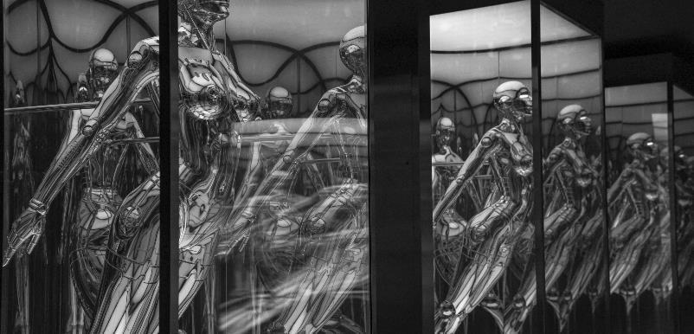
A Final Word and Reporting Concerns

Slide 17
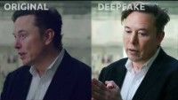
“90% people cannot tell the difference”

Slide 18
Actions to take away …..
Review policies and processes to consider and reference AI.
Consider adding in a declaration to applications and interviews to ensure applicants disclose the use of AI.
Maintain awareness – keep up to date with technology developments.

Slide 19
Reporting Concerns.
Report your concerns to your Local Counter Fraud Specialist or to the NHS Counter Fraud Authority.
Keep your concerns confidential – remember the wider you report the more chance of undermining a case.
Consult your organisation’s Fraud, Bribery and Corruption Policy.

Slide 20

Contacting the Local Counter Fraud Specialist or the NHS Counter Fraud Authority
Your organisation webpages.
The organisation’s Fraud, Bribery and Corruption Policy.
Counter Fraud Authority website: www.cfa.nhs.uk.
NHS fraud affects us all.
Together, we can make a difference!

